Slide 1


Odd Semester Project (Part I ) Exam
AY 2018-2019
Group Members Names:
(1) Viral Haria
(2) Suraksha More
(3) Bijal Patel
Under the Guidance of : Mrs. Harshali Patil

Slide 2
Index
Abstract
Introduction
Literature Review
Objectives of Project
Project Planning ( 15 weeks 7 Sem, 15 weeks 8 Sem)
Proposed Work
Methodology (Algorithms and Performance Parameters)
DFD / Physical Layout/System Architecture/Block Diagram
UML Diagrams
Algorithms
Flowchart
UI Design(Snapshots)
Applications and Future Scope
Conclusion
References

Slide 3
Abstract
Disease diagnosis is not an easy task, especially without proper equipment. This problem can be solved using some machine learning techniques. Till now there has been various researches and heart diseases, or so have been predicted appropriately using such techniques. Not much work has been done on thyroid and so, in this project we try to implement prediction of thyroid disease system.
This project builds a system which helps predict a normal person about his possibility of getting thyroid in future.
The algorithm is first trained using the data set available from UCI repository and then tested on the data set. Then the user enters his details and the algorithm starts running, according to the values entered by the user the algorithm predicts that the user will be having thyroid in future or not.
This system will help doctors as well as individuals to have a possible disease diagnosed. And once a person predicts whether or not he can be diagnosed with thyroid disease in the future, our system will be giving suggestions like blogs of experts, doctors etc. recommending home remedies, homeopathic and ayurvedic medicine suggesting sites etc.

Slide 4
Introduction
Diagnosis of diseases is a very complex and difficult task, requiring a lot of experience and knowledge. Usually people physically go to doctors’ clinics for regular checkups or for diagnosis of some symptoms of any disease.
The thyroid gland, situated near the base of the throat, secrets a hormone thyroxine which controls many of the metabolic processes like blood pressure, body weight and temperature. The thyroid disease can be caused due to an under-secretion or an over-secretion of thyroxine. Thyroid disease is very common illness among people living in hilly regions.
The symptoms of this disease are usually not easily detected because it varies depending on the type and hence proper medicines cannot be provided on time. Diagnosis can often be done with laboratory tests.
Data mining and machine learning is the way of semi-automatically classifying and analyzing large datasets to find what amount of the data can be grouped into a single category and then using those categories to accurately predict from the new, growing datasets.

Slide 5
Literature Review
Sr. No. | Title | Author | Year Published | Results
1. | “Machine Learning Techniques for Thyroid Disease Diagnosis – A Review” | Shaik Razia and M. R. Narasinga Rao | July 2016 | Given a study about previous ANN papers. Also discussed how the ANN can be used in future for disease diagnosis.
2. | “Predicting Thyroid Disease using Linear Discriminant Analysis (LDA) Data Mining Technique” | G. Rasitha Banu | January 2016 | Dataset is taken from UCI Repository and weka tool is used for processing it. K-fold cross validation is performed with k=6.
3. | “Predictive Data Mining for Diagnosis of Thyroid Disease using Neural Network” | Prerana, Parveen Sehgal and Khushboo Taneja | April 2015 | In this paper, MATLAB Neural Network Toolbox software is used to classify thyroid disease. Levenberg Marquardt method has shown better performance than simple gradient descent algorithm.

Slide 6
Literature Review and Gap Identified
Sr. No. | Title | Author | Year Published | Results
4. | “Predicting Thyroid Disease using Datamining Technique” | Dr. G. Rasitha Banu, M. Baviya | March 2015 | 1. DBSCAN algorithm along with Hierarchical multiple classifier classification scheme is used.
5. | “Applying Classification Algorithms to Predict Thyroid Disease” | S. Umadevi and Dr. K. S. Jeen Marseline | October 2017 | Comparison of 3 classifier – K Nearest Neighbours (80%), Artificial Neural Network (85%) and Fuzzy Artificial Neural Network (90%) is performed. 4 feature selection methods are also presented – MI, RSFS, SFS and SD.
6. | “An Experimental Comparative Study on Thyroid Disease Diagnosis Based on Feature Subset Selection and classification” | M. R. Nazari Kousarrizi, F. Seiti and M. Teshnehlab | February 2012 | Two feature selection methods discussed – genetic algorithm and sequential forward selection. Support Vector Machine gives the best accuracy.
*DBSCAN: Density-based spatial clustering of applications with noise.

Slide 7
Objectives of Project
To be able to fetch the dataset and train the system.
Able to store the reports of the user and make it available to the user.
To be able to predict whether a patient will be having thyroid in future.
Suggest websites and blogs providing home remedies in this field.
To validate that 80% of the written code executes according to specification we make -use of automatic test cases.

Slide 8
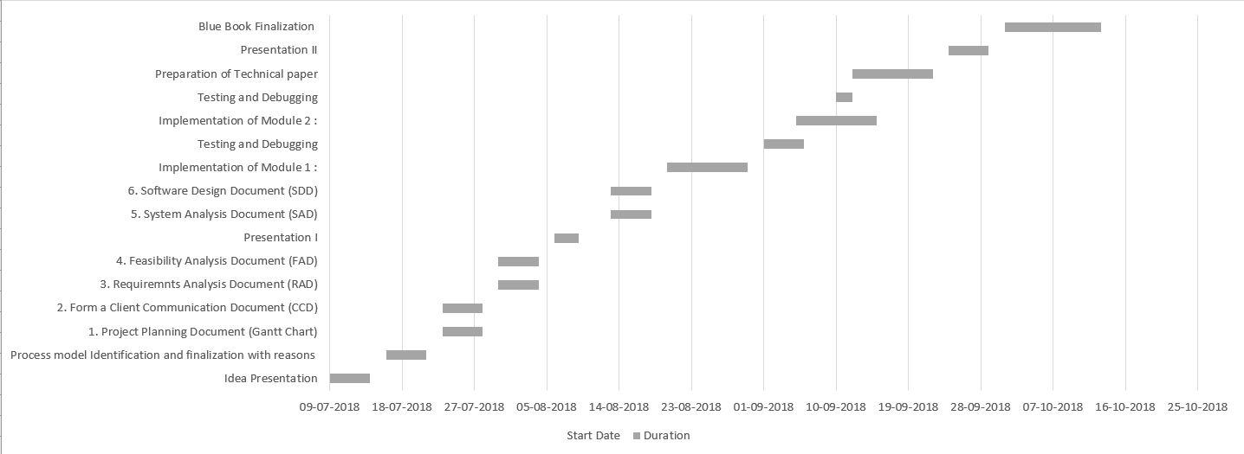
Project Planning

Slide 9
Proposed Work
Proposed work is to build a Thyroid Disease Prediction System which accurately predicts the chances of Thyroid Disease based on the inputs provided by the users.
The system must be able to store the records of the patients for future reference.
The system will provide similar thyroid facing blogs and some home remedies website based on the result.

Slide 10
Methodology
Technology used at front end: HTML, CSS, Bootstrap
Technology used at Back end: Python and php
Resources Required: Manpower, Programmers, testers, debuggers
Software required: Testing Tools (to perform black box and white box testing), GitHub
Hardware required: PC for development, server for deployment

Slide 11
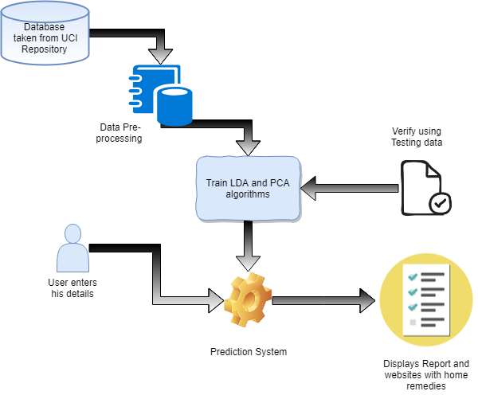
System Architecture

Slide 12
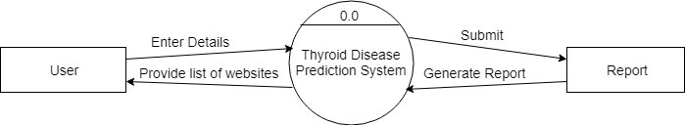
DFD Level 0

Slide 13
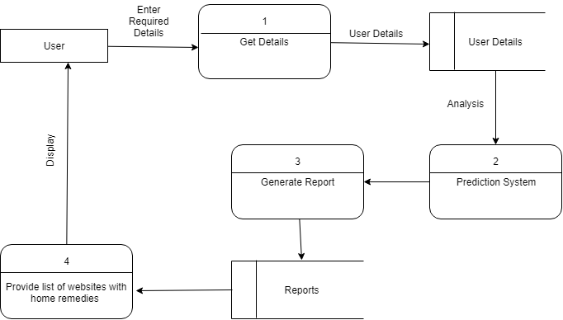
DFD Level 1

Slide 14
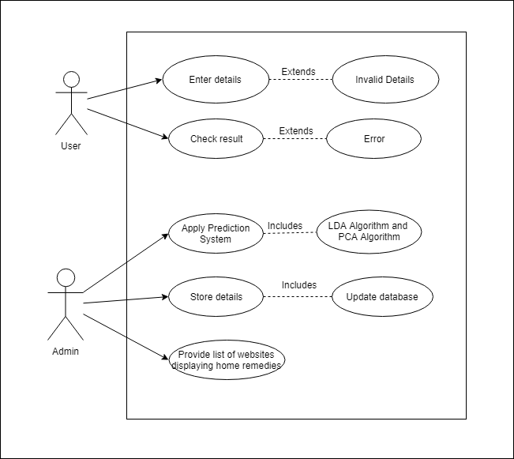
UML Diagrams - Use Case Diagram

Slide 15
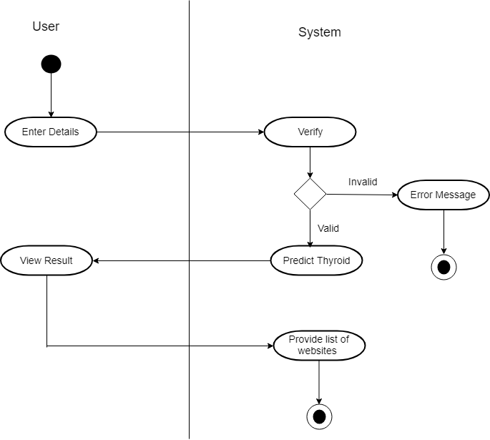
UML Diagrams - Activity Diagram

Slide 16
Algorithms -PCA
PCA, an algorithm mostly used for making predictive models, is used when there are many variables and we need to find correlation between them.
It is a statistical procedure that uses an orthogonal transformation to convert a set of observations of possibly correlated variables into a set of values of linearly uncorrelated variables called principal components.

Slide 17
Algorithms - LDA
Linear Discriminant Analysis (LDA) is basically a classification algorithm which is based upon the concept of finding a linear combination of two or more variables that can most accurately distinguish between two classes.
The LDA algorithm makes prediction by estimating the probability of a new set of input belong to which category or class. To do so, the probability of the new set of input belonging to each class is calculated and the class with maximum probability is predicted to be the output.

Slide 18
Algorithms – Difference between LDA and PCA
Both the algorithms - LDA and PCA perform almost the same thing but LDA algorithm focuses on maximizing the separability among classes.
PCA basically focuses on reducing the dimensionality of the data set and retaining the dataset variations to the maximum extent.

Slide 19
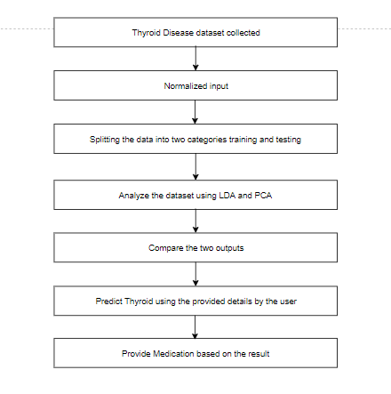
Flowchart

Slide 20
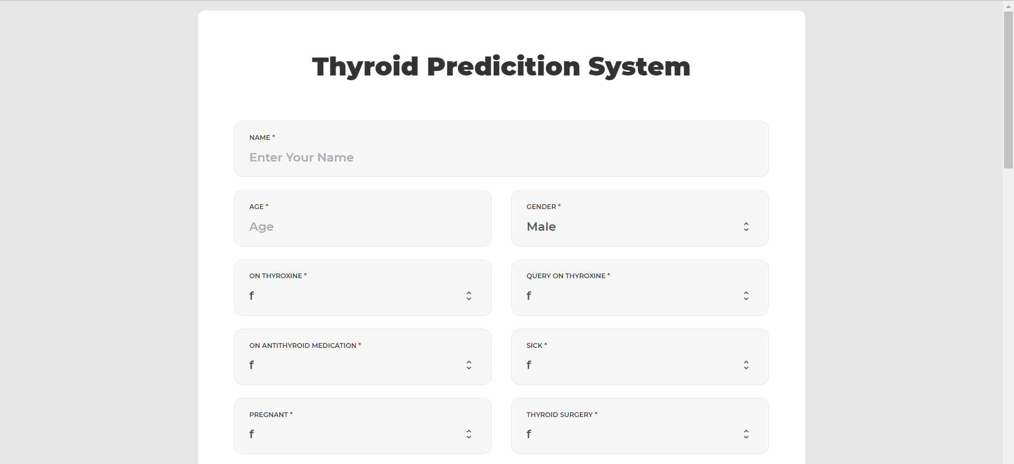
UI Design (Snapshots)

Slide 21
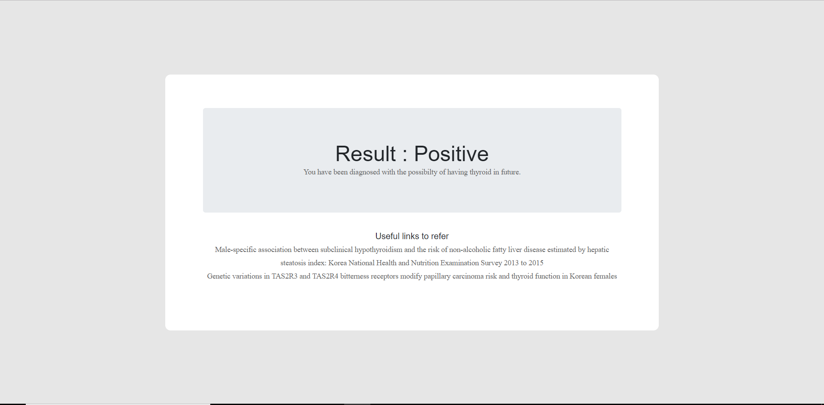
UI Design (Snapshots)

Slide 22
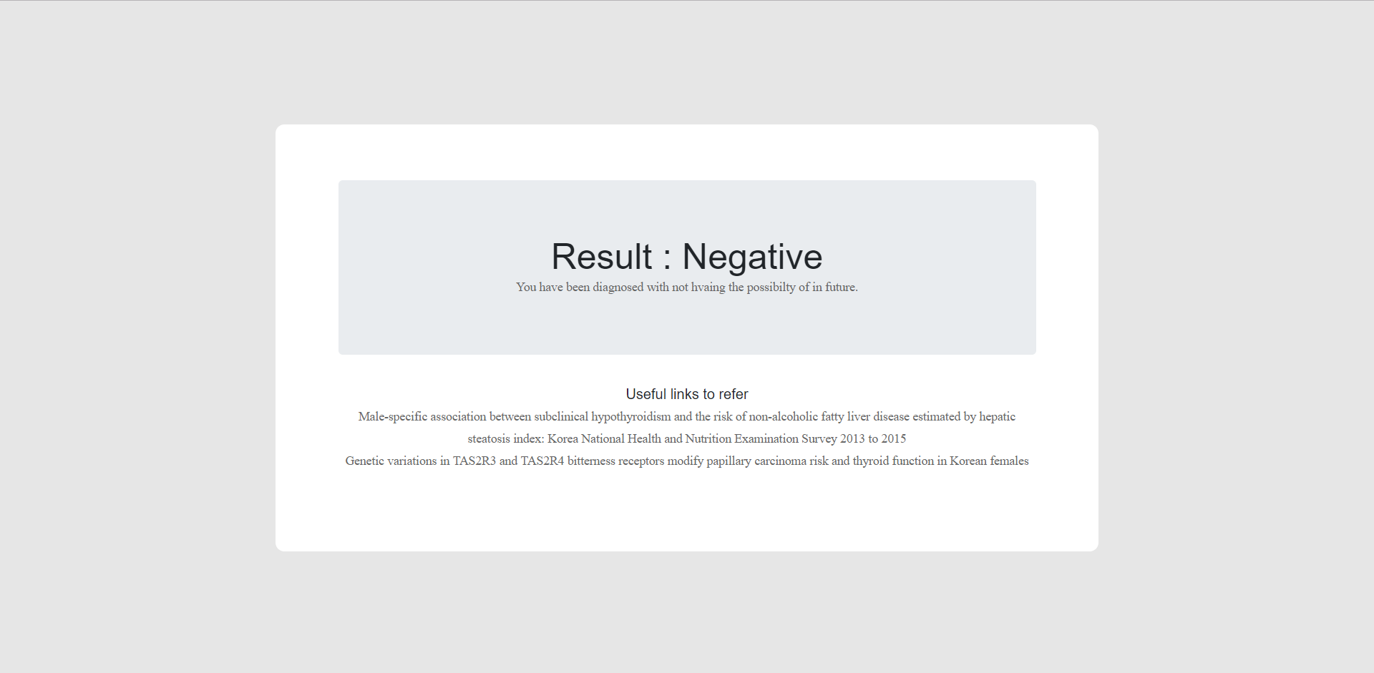
UI Design (Snapshots)

Slide 23
Applications and Future Scope
Doctors can be given a special access to the system so that they can give proper guidance to the users using it.
A list of nearest stores having the required resources for the recommended home remedies can be shown.
Practicing doctors can use the portal as an important resource to study the trends and the rate of the thyroid disease.
The system can be expanded and the algorithms can be used similarly to predict other diseases with maximum accuracy as well.

Slide 24
Conclusion
In this project, we are building a Thyroid Disease Prediction system which uses machine learning techniques to predict Thyroid Disease. It consists of an information page which takes inputs from the user. It consists of information such as users name, age, gender, thyroxine details, antithyroid medication details, hypo thyroid, hyper thyroid, etc. After giving the input the user clicks on predict button. The system will predict whether the user will thyroid or not.
The system uses two machine learning algorithms: LDA and PCA. We will be using both the algorithms to maximize the accuracy for the prediction based on the user’s input. The system provides with the list of websites for further reference and also provides home remedies to cure thyroid.
Thyroid disease is one of the major diseases and prediction of it is very difficult task to complete without using a computer technology. Disease diagnosis plays a vital role and it is necessary for any busy clinician. Hence this system will be very useful for the users.

Slide 25
References
Shaik Razia and M. R. Narasinga Rao, “Machine Learning Techniques for Thyroid Disease Diagnosis - A Review”, Indian Journal of Science and Technology, Vol 9(28), DOI: 10.17485/ijst/2016/v9i28/93705, July 2016
G. Rasitha Banu, “Predicting Thyroid Disease using Linear Discriminant Analysis (LDA) Data Mining Technique”, Communications on Applied Electronics (CAE) (ISSN : 2394-4714), Volume 4– No.12, January 2016
Prerana, Parveen Sehgal, Khushboo Taneja, “Predictive Data Mining for Diagnosis of Thyroid Disease using Neural Network”, International Journal of Research in Management, Science & Technology (E-ISSN: 2321-3264) Vol. 3, No. 2, April 2015
Dr. G. Rasitha Banu, M.Baviya, “PREDICTING THYROID DISEASE USING DATAMINING TECHNIQUE”, International Journal of Modern Trends in Engineering and Research (IJMTER) Volume 02, Issue 03, [March - 2015] e-ISSN: 2349-9745, p-ISSN: 2393-8161
“UCI Machine Learning Repository of machine learning database”, University of California, School of Information and Computer Science, Irvine, C.A. http://www.ics.uci.edu/.

